Slide 1
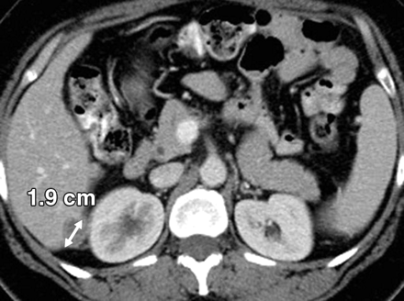

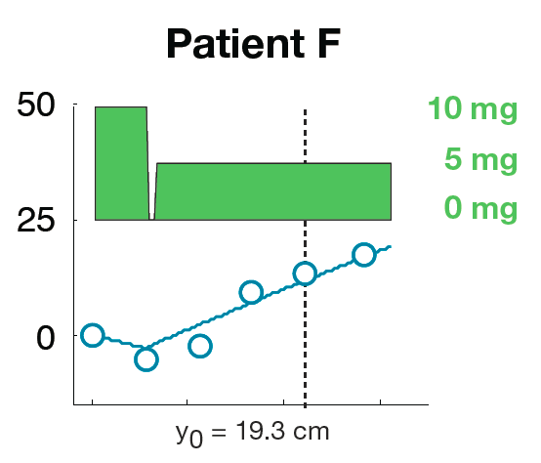

Dose selection in solid tumor trials: Making use of all available tumor data.
Response Criteria for
Solid Tumors (RECIST)
Dose Response
50
25
Target Lesion (%)
Change from Baseline
0
0 100 200 300
Time (days)
PhUSE Boston – June 20, 2013
Andrew Stein
andrew.stein@novartis.com

Slide 2
Overview
Oncology Phase III trials have a >40% failure rate¹
When choosing the dose for Phase III, drug development teams do not take full advantage of the moderately rich tumor data that is available.
We are developing methodologies for dose selection that take into account all available data, which could potentially lead to reduced failure rates, more efficient trials, and better characterization of the benefit-risk ratio.
1. DiMasi JA and Grabowski, J Clin. Oncol., 25, 209 (2007)

Slide 3
Background: Solid tumors are imaged using 3d Xray images, i.e. computed tomography (CT)

Slide 4
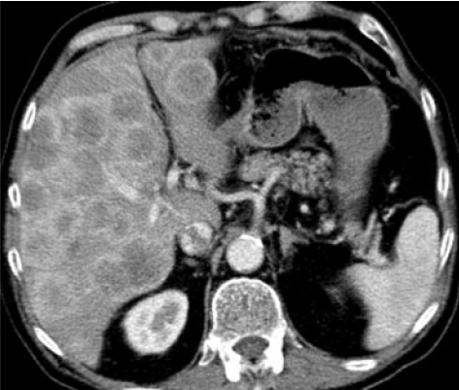
Background: RECIST¹ lesion types
Target Lesions
1-2 “representative” lesions per organ
Lesions must be measurable
Longest diameter recorded and summed (SLD²)
Target Lesion
Nontarget Lesions
When >1-2 lesions exist per organ
“Unmeasurable” lesions
Categorical response recorded
Ovarian cancer metastasis in liver
Nontarget Lesions
New Lesions
Detectable only after the start of therapy
Binary response (yes/no) recorded
1. RECIST = Response Evaluation Criteria In Solid Tumors
2. Sum of the Longest Diameters
Rectal cancer metastases in liver.

Slide 5
Background: Patient response is summarized by single value measurements; some information is lost
RECIST¹ data with dosing history
Time (months) | 0 | 2 | 5 | 7 | 10
Dose (mg)
Target Lesion SLD² (cm)
Nontarget Lesion |  | SD | SD | SD | SD
New Lesion |  | No | No | No | Yes
Response |  | PR | PR | PR | PD
10 mg
5 mg
0 mg
Single value measurements:
Time to Progression | 10 mo.
Best Overall Response | PR
Best Percent Change in SLD | 55%
6 cm
4 cm
2 cm
Summary statistics based on single value measurements are then used to compare trial arms
1. RECIST = Response Evaluation Criteria In Solid Tumors SD = Stable Disease
2. SLD = Sum of Longest Diameters of target lesions PR = Partial Response
PD = Progressive Disease

Slide 6
Background: How can we use all available tumor data to better select the dose of new drugs?
Standard efficacy endpoints do not incorporate all available data.
Median Overall Survival (OS)
Median Time to Progression (TTP)
Best Overall Response
Missing data includes
Phase I trials can have many dose interruptions and dose escalations, but individual dosing history is ignored.
Heterogeneous lesion response is ultimately summarized by only 1-2 binary variables (Progression: yes/no, Response yes/no).

Slide 7
We are developing new methods for modeling tumor data for identifying the most efficacious dose.
Using longitudinal tumor data, we characterize a difference between two doses, which was not possible using standard statistical approaches.
Taking into account multivariate lesion assessment is essential for predicting overall survival.
We have developed multivariate, longitudinal models to capture the full dose-efficacy dataset of all lesion types.

Slide 8
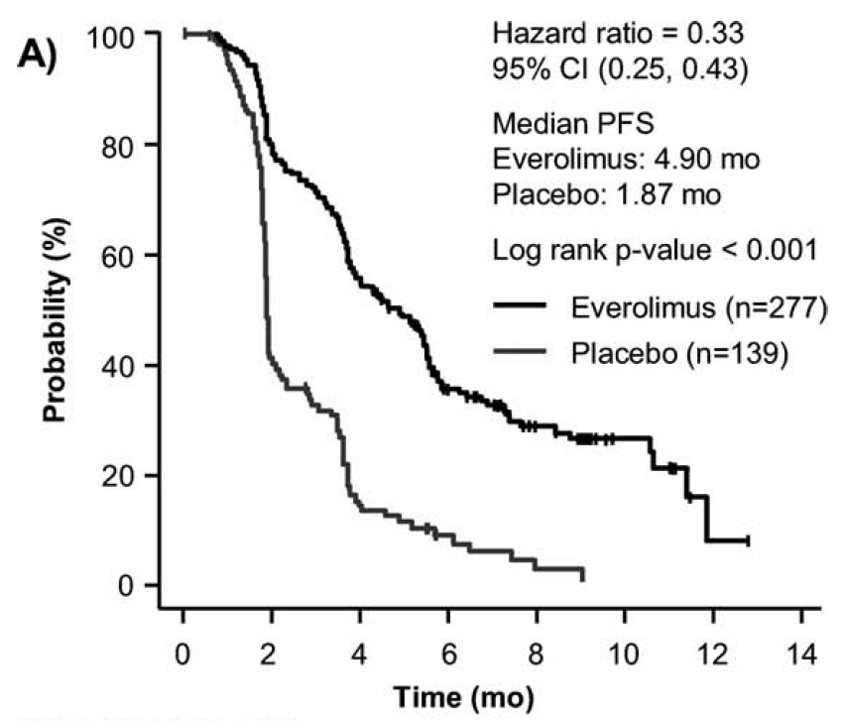
Background Example: clinical trial comparing everolimus to placebo in renal cell cancer
RAD001C2240: Phase III pivotal trial comparing everolimus 10mg to placebo in 2nd/3rd line renal cell cancer patients.
Progression free survival was the primary end point.
Results demonstrated superiority of everolimus 10mg over placebo.
Comparison of trial arms:
Log rank p-value < 0.001
% of pts. who have not progressed
Everolimus (N=277)
Median PFS = 4.9 mo
Placebo (N=139);
Median PFS = 1.9 mo
Time after randomization (months)

Slide 9
Background: The RAD001C2240 trial with no 5mg arm contains information about the 5mg response.
Many patients (N=98) were dose- reduced from 10mg to 5mg due to adverse events
Is 10mg superior to 5mg? Should patients who are dose-reduced to 5mg be re-challenged with 10mg?
Standard statistical tools cannot answer these questions because there was no prospective 5mg arm in the trial.
Model-based tools can address these questions by relating the daily dosing history to tumor response over time.
Individual Patient
10mg
5mg
Dose reduction due to an adverse event
Observed solid tumor data from an individual patient: In this patient, target lesions appear to shrink under 10mg, but grow under 5mg.

Slide 10
#1 We first focus on using the longitudinal, continuous, target lesion data to compare doses.
RECIST¹ data with dosing history
Time (months) | 0 | 2 | 5 | 7 | 10
Dose (mg)
Target Lesion SLD² (cm)
Nontarget Lesion |  | SD | SD | SD | SD
New Lesion |  | No | No | No | Yes
10 mg
5 mg
0 mg
6 cm
4 cm
2 cm
1. RECIST = Response Evaluation Criteria In Solid Tumors SD = Stable Disease
2. SLD = Sum of Longest Diameters of target lesions PR = Partial Response
PD = Progressive Disease

Slide 11
Methods: model based approach for describing individual patient data.
Modeling approaches describe the daily change in tumor size for each individual patient.
Tumor Size (y [cm] )
Change over Time (t [days])
Placebo
Growth Rate [cm/day]
Drug
Effect
[cm/day]
=
–
dy/dt
=
r
–
[Eff_{dose(t)}]*y
Using each individual’s dosing history and longitudinal tumor size data, we fit all patients from the trial using a nonlinear mixed effect model.

Slide 12
Results: The model well describes representative patient data. 10mg was more effective than 5mg.
KEY
Measured SLD¹
Dose
Model fit
10mg
5mg
0mg
Placebo patients that cross over to Everolimus
10mg
5mg
0mg
Patients on 10mg
10mg
5mg
0mg
Patients reduced from 10mg to 5mg
1. SLD = Sum of Longest Diameters of target lesions

Slide 13
Conclusions: Modeling approaches can describe response to 5mg, even without a 5mg arm
Analysis supports 10 mg as starting dose.
Analysis demonstrates that 5 mg is superior to placebo when dose reductions are necessary.
Analysis suggests that patients who are dose-reduced to 5 mg may benefit from a re-challenge at 10 mg.
Results were published in BMC Cancer¹.
Simulation
Error bars denote intersubject-variability (±35%)
Stein et al., BMC Cancer, 12:311, 2012

Slide 14
#2: We next focus on predicting survival using the first post-baseline multivariate assessment
RECIST¹ data with dosing history
Time (months) | 0 | 2 | 5 | 7 | 10
Dose (mg)
Target Lesion SLD² (cm)
Nontarget Lesion |  | SD | SD | SD | SD
New Lesion |  | No | No | No | Yes
10 mg
5 mg
0 mg
6 cm
4 cm
2 cm
1. RECIST = Response Evaluation Criteria In Solid Tumors SD = Stable Disease
2. SLD = Sum of Longest Diameters of target lesions PR = Partial Response
PD = Progressive Disease

Slide 15
Methods: Cox regression is used to establish the effect of each tumor measure on survival
Only patients on the everolimus arm are analyzed.
Response at first assessment (month 2) is correlated with overall survival using Cox regression.
Survival
[Days]
Change in Target Lesion Size
(Δy = %)
Progression of Nontarget Lesion
(Non = 0/1)
Appearance of New Lesion
(New = 0/1)
=
~
Survival Hazard
~
a₁*Δy
+
a₂*Non
+
a₃*New
{a₁, a₂, a₃} are Cox coefficients linking each patient measurement to survival.

Slide 16
Results: Change in the sum of the longest diameters (SLD) was not predictive of survival.
Target Lesion
Sum of Longest Diameters
(SLD)
SLD Growth
SLD Reduction
SLD = Sum of Longest Diameters of target lesions

Slide 17
Results: Nontarget lesion progression at month 2 was predictive of survival
Nontarget Lesion
Progression
Target Lesion SLD
SLD Growth
No Progression
SLD Reduction
Progression
p = 0.0001
SLD = Sum of Longest Diameters of target lesions

Slide 18
Results: New lesion appearance at month 2 was predictive of survival
New Lesion
Appearance
Target Lesion SLD
SLD Growth
No New Lesions
SLD Reduction
New Lesion
p = 0.0001
SLD = Sum of Longest Diameters of target lesions

Slide 19
Is there another way we can look at target lesion data that would make it predictive?
Hypothetical Patient
Sum of longest diameters (SLD)
Lesion #1
SLD (cm)
Lesion #2
Lesion #3
Time
Resistant
Proposal: look at the “worst lesion” instead of the sum to account for known heterogeneity in tumor response¹
SLD = Sum of longest diameters of target lesions
1. Gerlinger et al., NEJM, 366, 883 (2012).

Slide 20
Results: Looking at growth/shrinkage of the “least responsive” lesion was predictive of survival
Behavior of
“worst” lesion
Target Lesion SLD
SLD Growth
All lesions
shrink
At least one
lesion grows
SLD Reduction
p = 0.03
SLD = Sum of Longest Diameters of target lesions

Slide 21
Conclusions
This work¹, adds to a growing body of literature²⁻⁴, demonstrating the importance of accounting for all lesion types (target, nontarget, new).
The heterogeneity of the target lesion response may also be useful in predicting survival.
Dose-response modeling methods should take into account the additional available data.
There is a need to further investigate use of image processing algorithms for capturing the dynamics of all lesions types
1. Stein et al., European Urology, in press, 2013. 2. Suzuki et al., Annals of Oncology, 23.948, 2012.
3. Mietlowski et al., J Clin. Oncol., abstr 2543, 2012 4. Litiere et al., J. Clin. Oncol., 30, abstr 10602, 2012

Slide 22
#3: Finally, we focus on modeling the full, multivariate tumor time-course.
RECIST¹ data with dosing history
Time (months) | 0 | 2 | 5 | 7 | 10
Dose (mg)
Target Lesion SLD² (cm)
Nontarget Lesion |  | SD | SD | SD | SD
New Lesion |  | No | No | No | Yes
10 mg
5 mg
0 mg
6 cm
4 cm
2 cm
1. RECIST = Response Evaluation Criteria In Solid Tumors SD = Stable Disease
2. SLD = Sum of Longest Diameters of target lesions PR = Partial Response
PD = Progressive Disease

Slide 23
Methods: Can we use the same model we had for the target lesions to also describe the new lesions?
Tumor Dynamics
Probability
of Detection
New Lesions
Continuous Data
Binary Data
dose
1.0
0.5
0
dose
yes
Lesion diameter (cm)
Prob. of Appearance
New Lesion
Appearance
no
0 1 2 3
Diameter (cm)
Time (days)
Time (days)
Probability of
Detection

Slide 24
Methods: The new lesion detection function can be estimated from literature data.
Imaging resolution has improved since 1999, so it is assumed that lesions that were 0.5 cm in diameter were detected with 50% probability.
Model also requires of an assumption of the initial lesion size (we choose 0.1cm)
1. Lorentz et al, Chest, 115; 720-724 (1999)

Slide 25
Methods: model based approach for describing individual patient data.
We model all three lesions types for each individual patient using the target lesion model.
Tumor Size (y [cm] )
Change over Time (t [days])
Placebo
Growth Rate [cm/day]
Drug
Effect
[cm/day]
=
–
dy/dt
=
r
–
[Eff_{dose(t)}]*y
Target lesions: fit model to sum of longest diameters (as before)
New lesions: use the “detection function” to transform the diameter (y) to a probability of detection between 0 and 1.
Nontarget lesions: construct a similar “progression function” to transform the diameter (y) to a probability of progression.

Slide 26
Results: The model well describes representative patient data.
Patient 1
Patient 2
Patient 3
Patient 4
Target
Lesion
Change
(%)
50%
25%
0%
Nontarget
Lesion
Progression
(yes/no)
yes
no
New
Lesion
Appearance
(yes/no)
yes
no
0 3 6 9 12
Time (months)
0 3 6 9 12
Time (months)

Slide 27
Results: Model can be qualified using the primary endpoint (Progression Free Survival)
Stein et al., J Clin Oncol, Abs#4602, 2011 (ASCO Poster)

Slide 28
Conclusions: 10 mg everolimus was superior to placebo, but 5- and 10-mg could not be differentiated
1.0
Placebo
For nontarget and new lesions, 5mg and 10mg could not be differentiated.
There may be a true lack of difference between the two doses in the nontarget and new lesions.
Poor resolution of categorical lesion data may make the dose-response relationship more difficult to detect.
Improved methodologies for characterizing nontarget and new lesions are warranted.
0.8
Nontarget
Lesion
Probability of
Progression
0.6
0.4
Everolimus
10mg
0.2
0
1.0
Placebo
0.8
New
Lesion
Probability of
Appearance
0.6
0.4
Everolimus
10mg
0.2
0
0 3 6 9 12
Time (months)

Slide 29
Next Steps
Add PK to model (has been done in other indications)
Improve resolution of the tumor data
Model each individual lesion instead of the sum
Integrate information from multiple readers
Apply automated algorithms for assessing the size of all available lesions (not just target lesions).
Characterize therapeutic window using safety data.

Slide 30
Recap: We have developed new methods for modeling tumor data for identifying the most efficacious dose.
Using longitudinal target lesion data, we characterize the difference in efficacy between two doses, which was not possible using standard statistical tools.
Taking into account multivariate lesion assessment is essential for predicting overall survival.
We have developed multivariate, longitudinal models to capture the full dose-efficacy dataset of all lesion types.
Next Steps: incorporate PK and explore the use of richer tumor data to capture additional efficacy information for dose selection.

Slide 31
Acknowledgements
M&S Oncology Cluster
Gabriel Helmlinger
Celine Sarr
Jerry Nedelman
Bill Sallas
Wenping Wang
Ovidiu Chiparus
Alison Carter
Varun Goel
Shu Yang
Marina Savelieva
Olesya Melnichenko
Kyle Lemoi (Intern)
Daniel Lusk (Intern)
BDM (Statistics)
Bill Mietlowski
Norbert Hollaender
Clinical Team
Dennis Kim
Sandra Chica
MPI Workshop (NJIT)
Linda Cummings
Richard Moore
Tom Witelski + team

Slide 32
backups

Slide 33
Everolimus showed similar effect on target lesions among patients with and without dose reductions.
Because there was not a randomized 5mg arm, the patients who are dose-reduced to 5mg represent a biased sample of patients who experience an adverse vent.
We compare the 10mg drug effect for patients with and without dose-reductions to see if tumor shrinkage is different across the different subgroups.
The right hand plot demonstrates that the effect of 10mg on tumor size is similar for both subgroups of patients, irrespective of whether the patient had an adverse effect.
Drug Effect in patients without (left) and with (right) dose interruptions is similar for both groups.

